Slide 1
Integrating Oral Health Into Social Marketing Campaigns
A Study Involving STEM Biomedical Science Students from Mrs. Diana Moore’s Class and Third Graders from Sweetwater Elementary School

Slide 2
Integrating Oral Health into Social Marketing Campaigns
By integrating oral health into existing elementary schools in the Lithia Springs community, this campaign will target the minds of young children from the ages of seven to eight years old. The project will be assisted by orthodontists from the local community as well as the LSHS biomedical STEM students pursuing careers in dentistry and public health. During the school year of 2017 -2018, we will be utilizing a collaborative approach. Oral health will be successfully integrated into the campaign as the following objectives will be encouraged: brushing teeth after lunch, decreasing consumption of sugar-sweetened beverages, and observing oral health as a means to determine additional internal health concerns.

Slide 3
Reward System: Take Teeth Cleaning from Boring to Brilliant!

Slide 4
Instant or Delayed Rewards?
Rewards will only succeed if they are tailored to suit each child, so you will need to work out what sort of system will work for your child.
If your child enjoys working toward a big prize, then try a reward chart. Award your children a sticker each time they clean their teeth properly or, if they are younger, sit nicely to have their teeth cleaned. Make sure you award the sticker right after a successful teeth cleaning session. When your children earn a certain number of stickers, give them a reward, such as a new toy or a trip to a favorite local attraction. If your children are old enough, they could choose their own treat to work toward.
If your children need instant rewards, you could try linking each teeth cleaning session to a prize. Offer an extra book at bedtime or some extra television time the following day. Make sure the reward comes soon after the task is completed. Remind your children why they are getting the reward so it is associated with good teeth cleaning.

Slide 5
Making Teeth Cleaning Fun
As well as traditional reward charts, you can also use rewards to make the actual process of cleaning teeth fun. Try these ideas to liven things up.
Use a little imagination to turn teeth cleaning into a game by singing a song or going on an imaginary journey.
If you have a tablet or smartphone, try an app, such as a kid’s timer, to ensure that your child brushes for the proper amount of time. Tell your child to use the app, but only as long the job is done properly.
You could also try this fun Colgate video which explains the importance of keeping those pearly whites clean and healthy.

Slide 6
Fun Videos for Children!
https://youtu.be/Jy8JurvYlH4
https://www.youtube.com/watch?v=ydvo_XU03s4
https://www.youtube.com/watch?v=dlbvzGGkmJs

Slide 7
Spanish Speakers

Slide 8
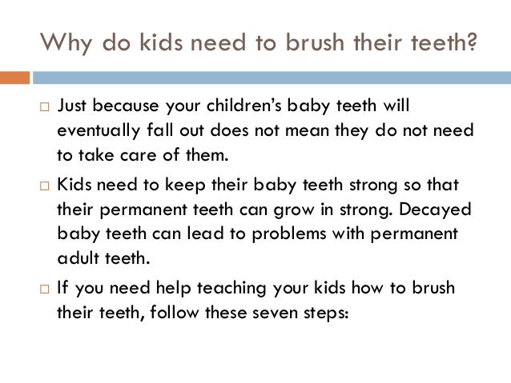
Parent Involvement in The Oral Campaign

Slide 9
Make it a family project as well !

Slide 10
It is more fun when we join in activities together!

